Slide 1
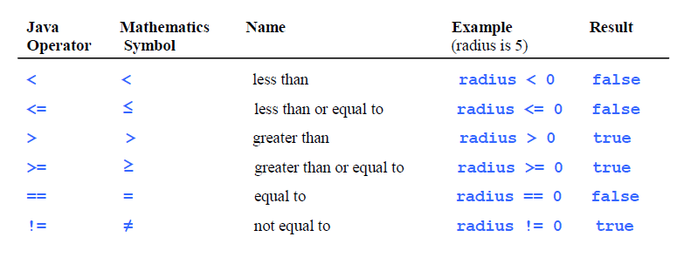
Boolean Operators
Often in a program you need to compare two values, such as whether i is greater than j. Java provides six comparison operators (also known as relational operators) that can be used to compare two values. The result of the comparison is a Boolean value: true or false.

Slide 2
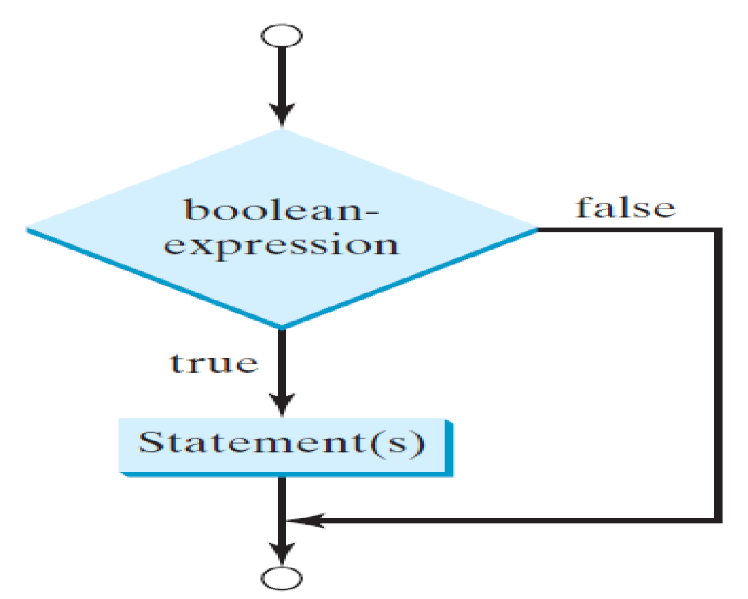
The one way If conditional statement
if (boolean-expression) { statement(s);}

Slide 3
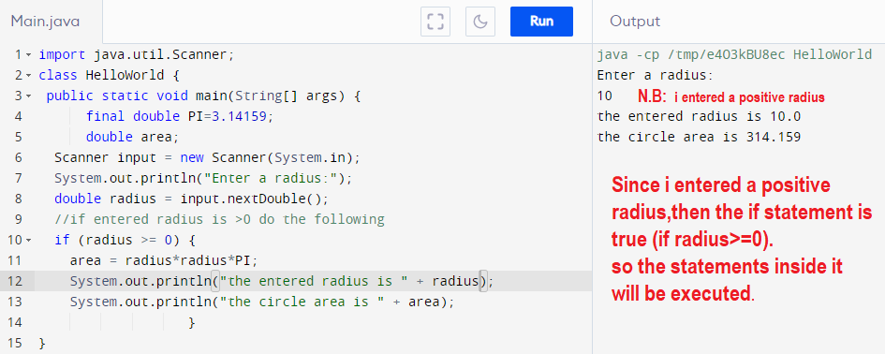
The one way If conditional statement cont

Slide 4
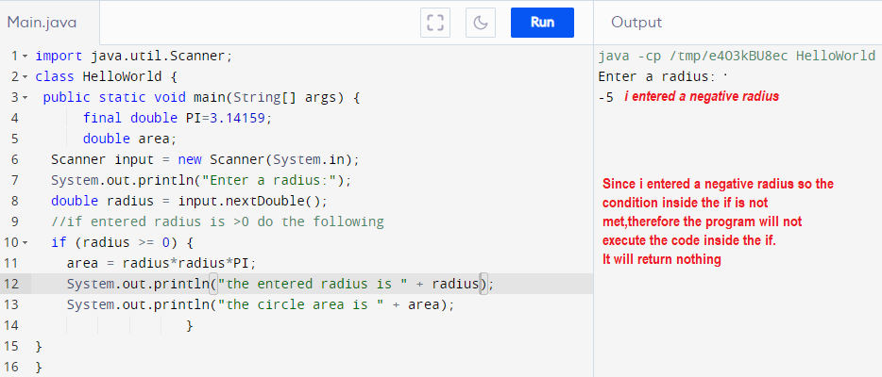
The one way If conditional statement cont

Slide 5
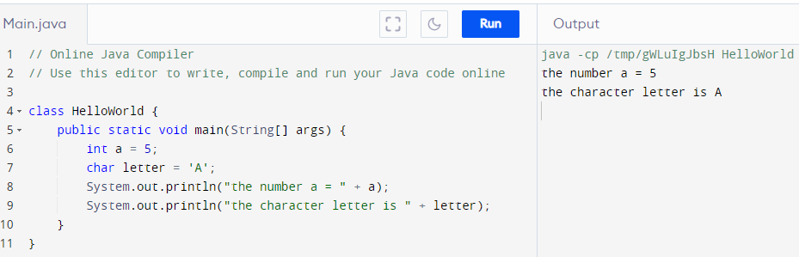
Character Data Type
To declare an integer you simply write int number = 5;
To declare a character you simply write char letter =‘A’;
example:

Slide 6
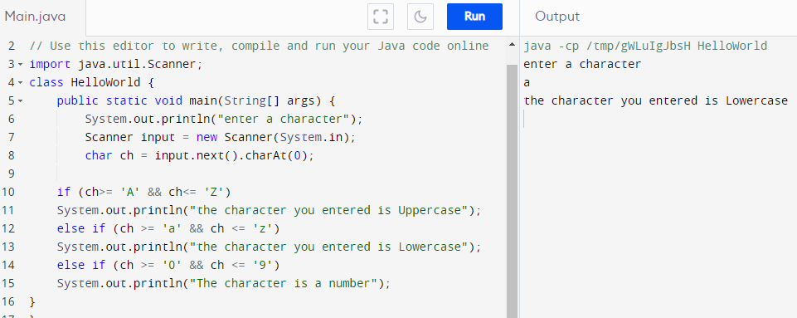
Reading a character from the console
First you create a scanner object.
Then you read it using .next().charAt(0);

Slide 7
Example cont
Let’s follow the steps.
At line 6 we told the system to print enter a character
Line 7: declare a Scanner to read a value and named it input.
Line 8: declare a char named ch and put inside it the input after grabbing the entered value from the user using .next().charAt(0).
Why charAt(0)? Why the 0?
let’s say you entered a word not a single character Ex: John
chartAt(0)= J charAt(1) = o charAt(2) = h charAt(3) =n
A coding example in the next slide.

Slide 8
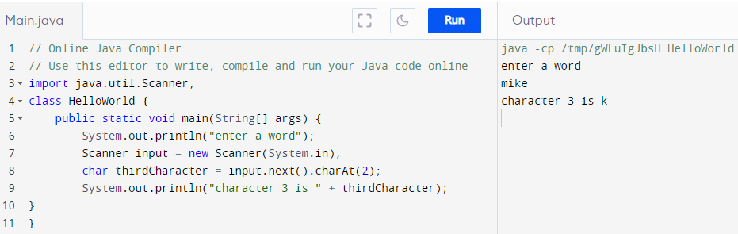
The charAt() method explained
The charAt() method is used to grab a character from a word based on the character’s number.

Slide 9
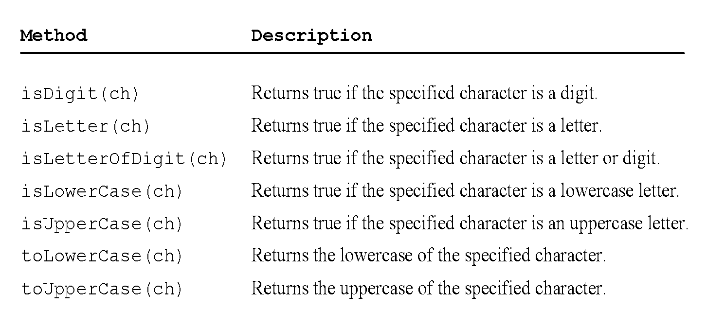
Methods in the Character Class

Slide 10
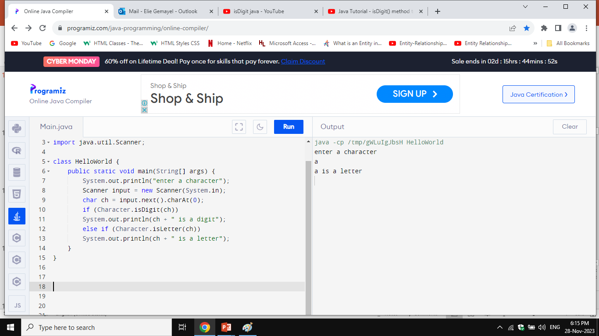
isDigit() and isLetter() methods

Slide 11
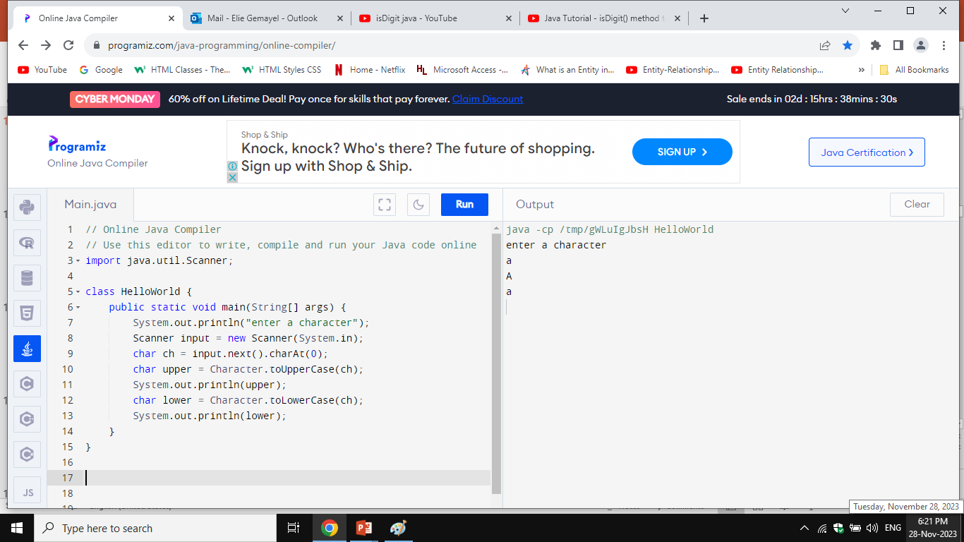
toUpperCase() and toLowerCase() methods

Slide 12
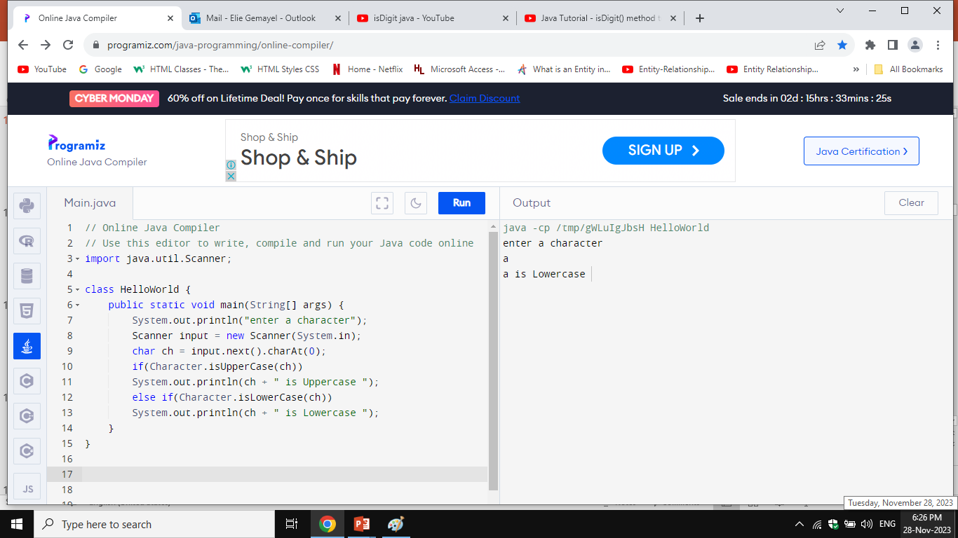
isUpperCase() and isLowerCase() methods

Slide 13
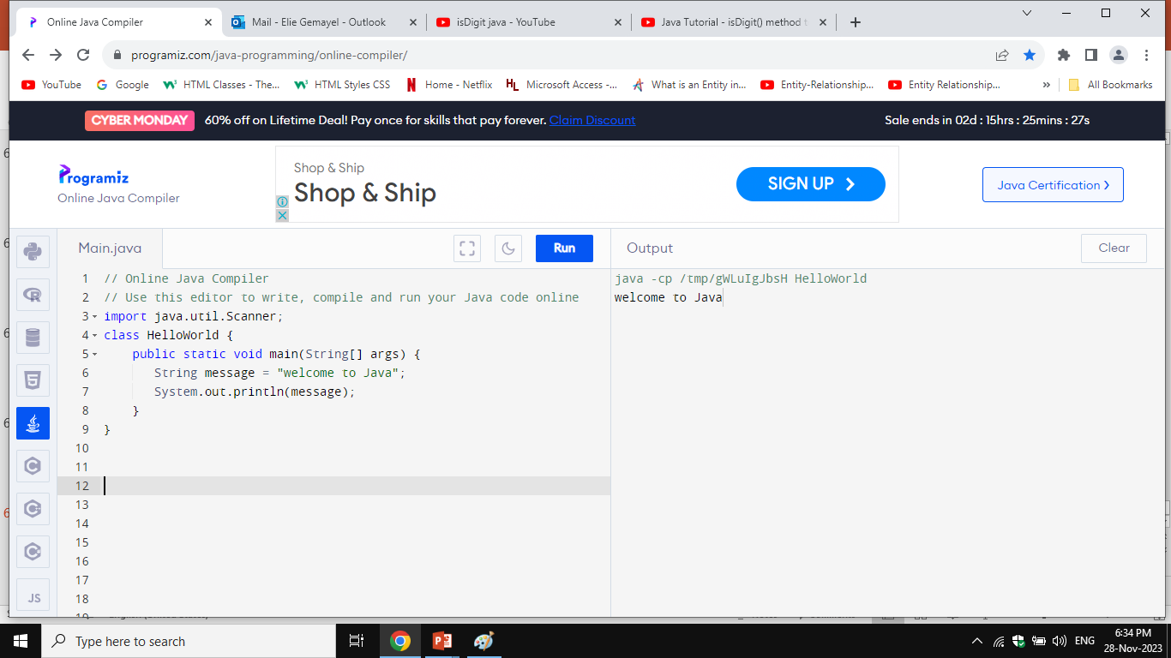
The String Type
The char type only represents one character. To represent a string of characters, use the data type called String. For example:
String message = "Welcome to Java";

Slide 14
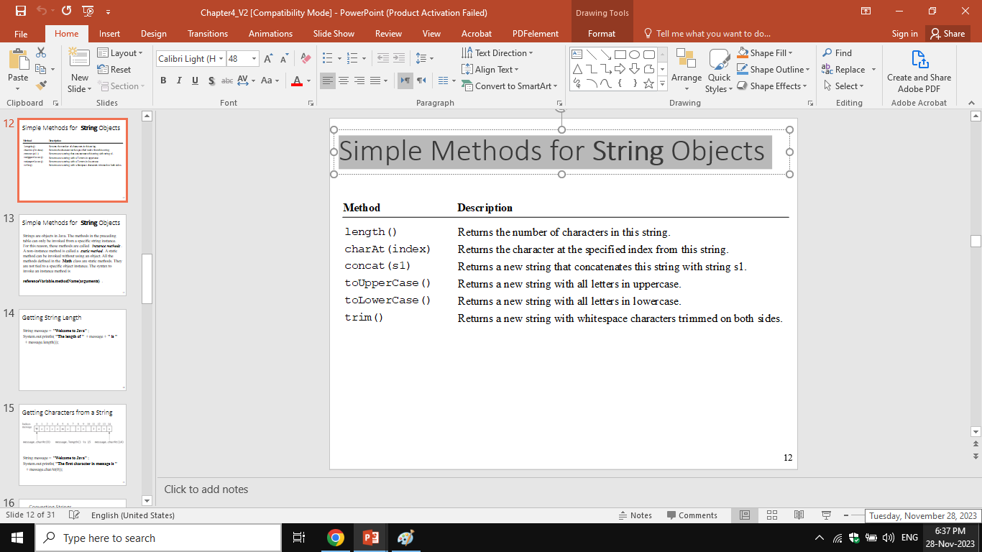
Simple Methods for String Objects

Slide 15
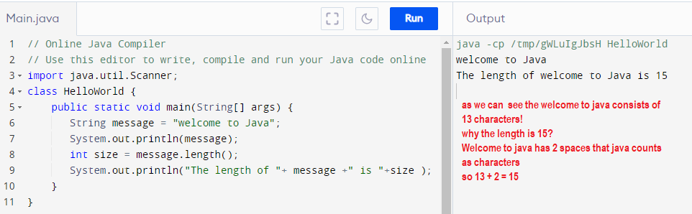
Getting String Length .length()

Slide 16
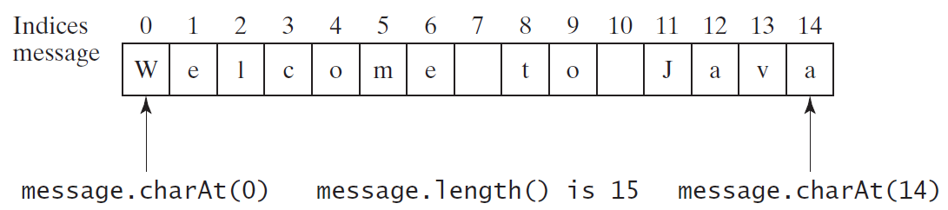
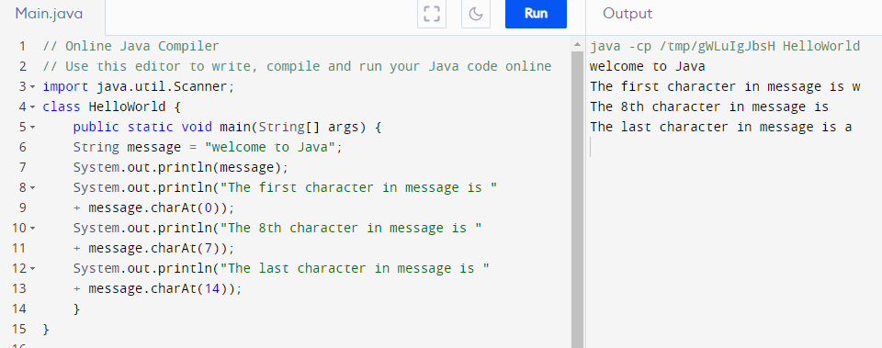
Getting Characters from a String charAt()

Slide 17
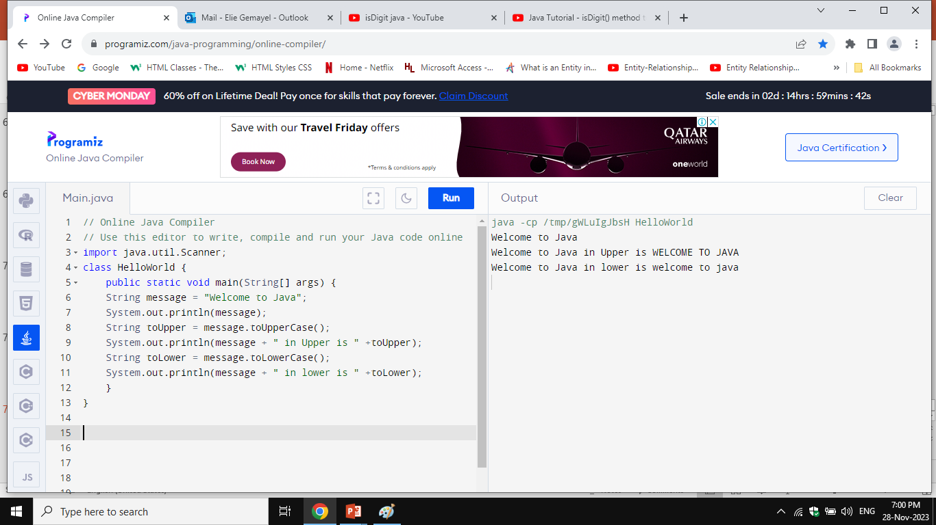
Convert String to Uppercase and lowercase
.toUpperCase() and .toLowerCase()

Slide 18
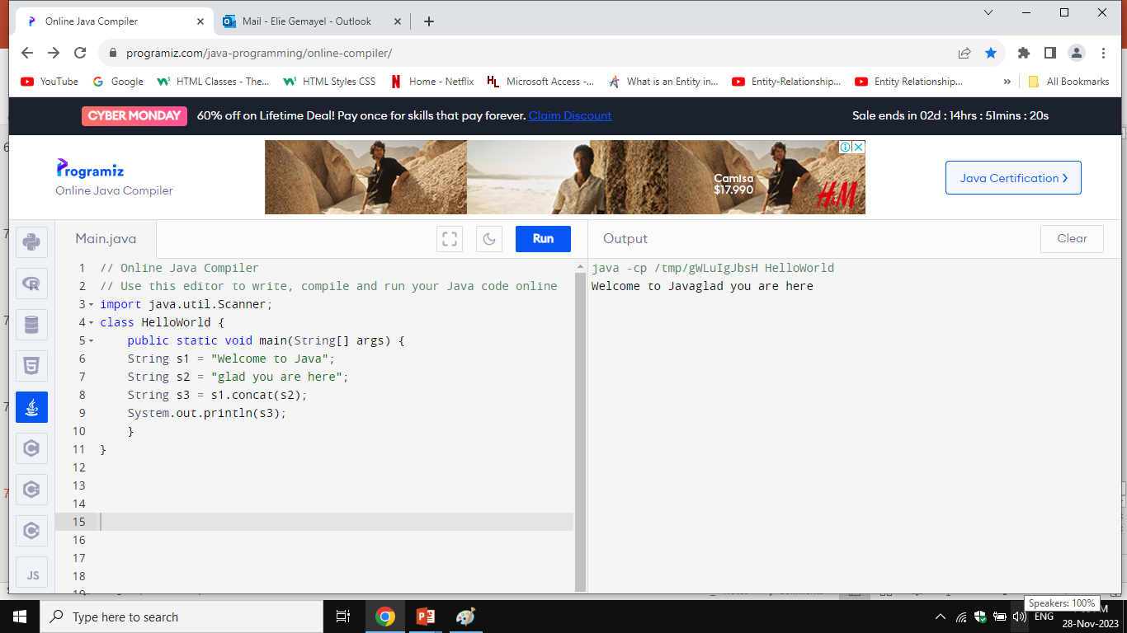
String Concatenation s1.concat(s2)(دمج)
This function concatenates 2 strings together.

